Slide 1
Evolution
Scientists

Slide 2
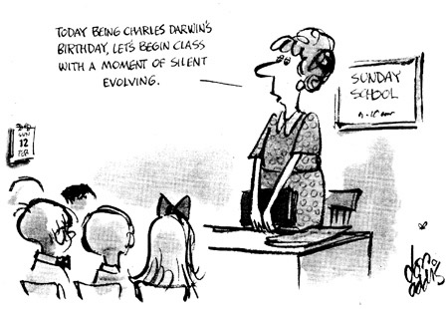
Evolution
** Charles Darwin’s theory of evolution by natural selection was shaped by the works of several other scientists **

Slide 3
Georges-Louis Leclerc, Comte de Buffon (1707-1788)
Created a 46 volume encyclopedia Historie Naturelle published in 1749
Discussed sources of biological variation and relationships among organisms
Identified similarities between apes and humans and considered a common ancestry (ancestry: history of ancestors)
Thought the environment acted directly on organisms by “organic particles” as a mechanism of evolution
His 1778 publication Les Epoques de la Nature was the first to challenge the religious belief that planet Earth was only 6,000 years old

Slide 4
Erasmus Darwin (1731-1802)
Charles Darwin’s grandfather
Discussed concepts of common descent, artificial selection by humans, vestigial organs, and the influence of competition and sexual selection on changes within a species in his work titled Zoonomia

Slide 5
I. Contributors to Darwin
Jean-Baptiste Lamarck (1744-1829)
first to propose a mechanism by which the gradual change of species might take place.
extended the definition of the change over time, saying that life started out simple and became more complex.
1809 - Philosophie Zoologique - described a two part mechanism by which change was gradually introduced into the species and passed down through generations.
Theory of Transformation or simply Lamarckism.
Use & disuse: using certain features and straining causes certain features to evolve (webbed feet long necks of giraffes)
Inheritance of Acquired Traits: traits changed or acquired over an individual's lifetime could be passed down to its offspring.

Slide 6
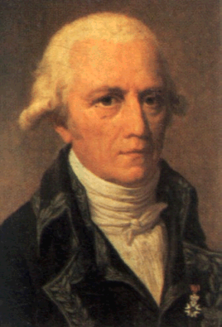
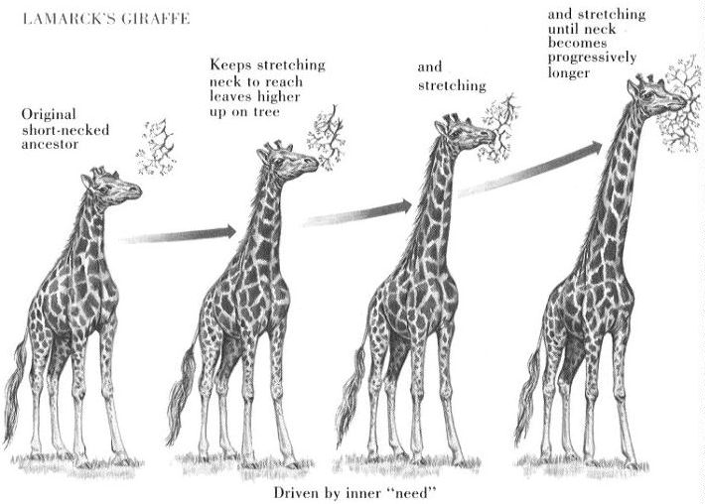
Lamarck

Slide 7
Charles Darwin (1809-1882)
Considered “The Father of Evolution”
In 1831, he boarded the HMS Beagle & started a 5 year voyage. He collected numerous specimens & logged detailed observations about each.
He primarily spent time in the Galapagos Islands, where he was especially intrigued by the different types of finches (birds).
At this time, the thought was that if the birds found on the island had migrated from the mainland, then they would be exactly the same as the birds on the mainland. Furthermore, if the birds had been created specifically for the island environment, then they would be completely different from the mainland birds.

Slide 8
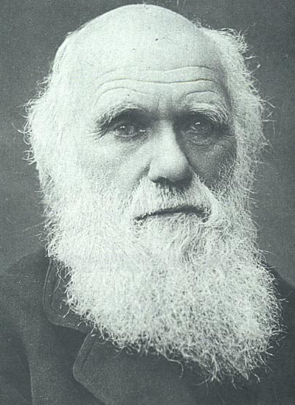
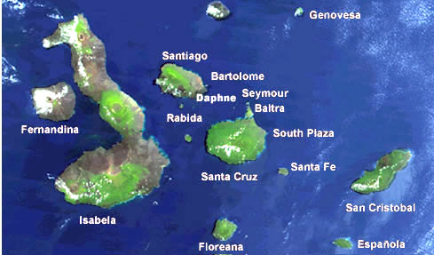
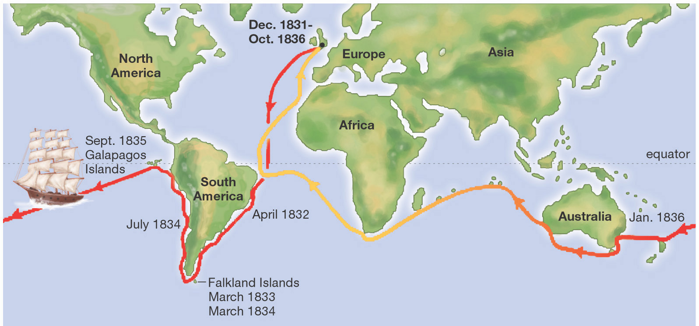

Slide 9
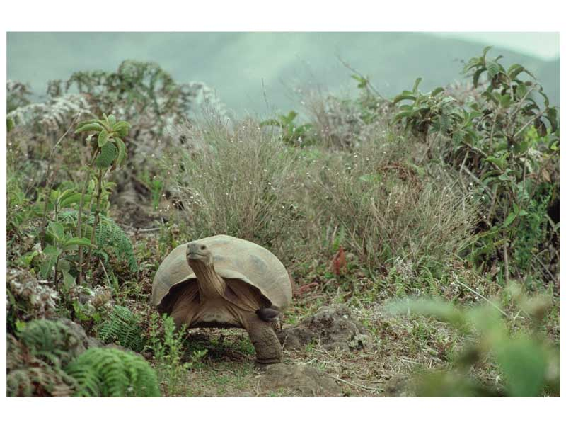
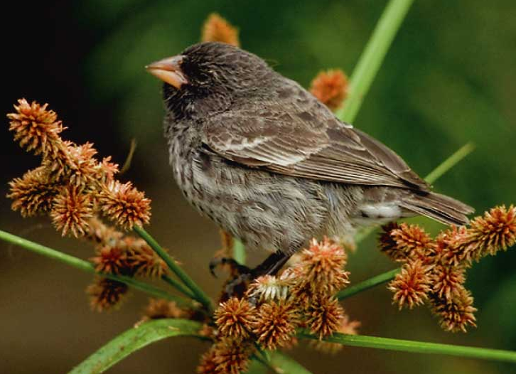
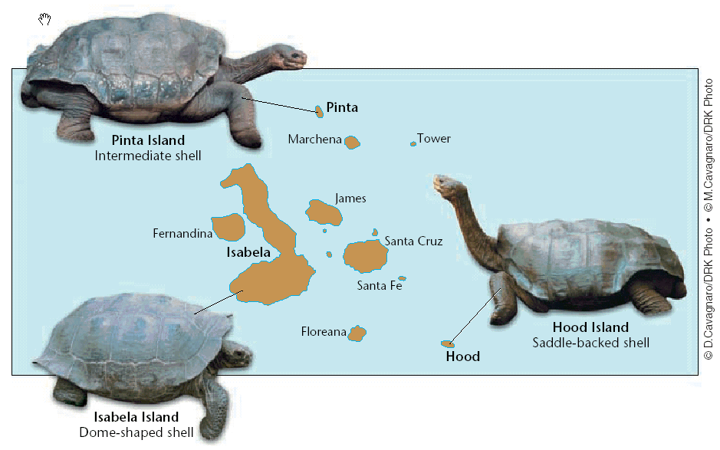
Instead, Darwin found that the birds were not completely different from mainland birds, and they were not completely the same either. This was what began the development of a common ancestor, which was the idea that these birds had evolved from the mainland birds, and since they had to survive tough environmental conditions, they adapted.
Darwin decided to wait 5 years to publish his ideas. When he did, he summed his ideas up in the book, On the Origin of Species.

Slide 10
On the Origin of Species summary:
All populations show the ability to change from one generation to the next.
Competition & variation lead to natural selection. Natural selection occurs when organisms have variations of traits that are more suitable to surviving and reproducing in its environment. Since organisms compete for resources, only the “strongest” will survive (“survival of the fittest” which is the theory of natural selection)
Natural selection led to the extinction of some species, vestigial structures (structures that no longer serve a purpose), and new species being formed by a steady but gradual accumulation of modifications (descent with modification)
Darwin concluded that all living things have a common ancestor that evolved over time, branched into separate species, and formed diverse forms of life that have either become extinct or exist today.

Slide 11
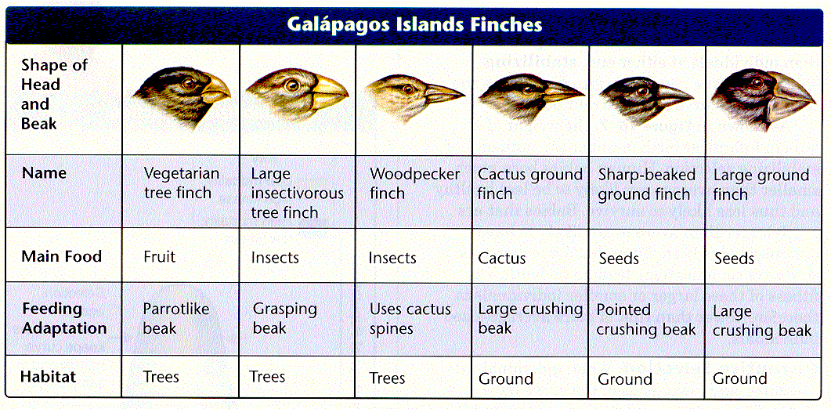

Slide 12
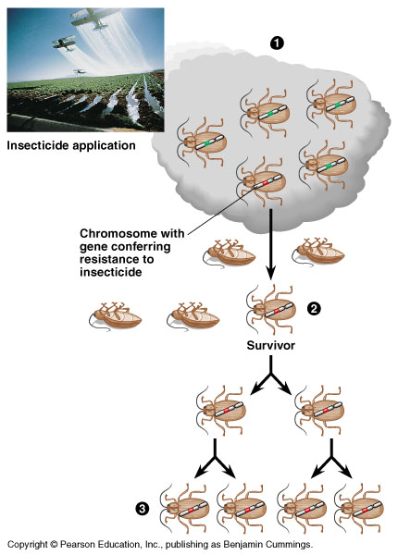

Slide 13
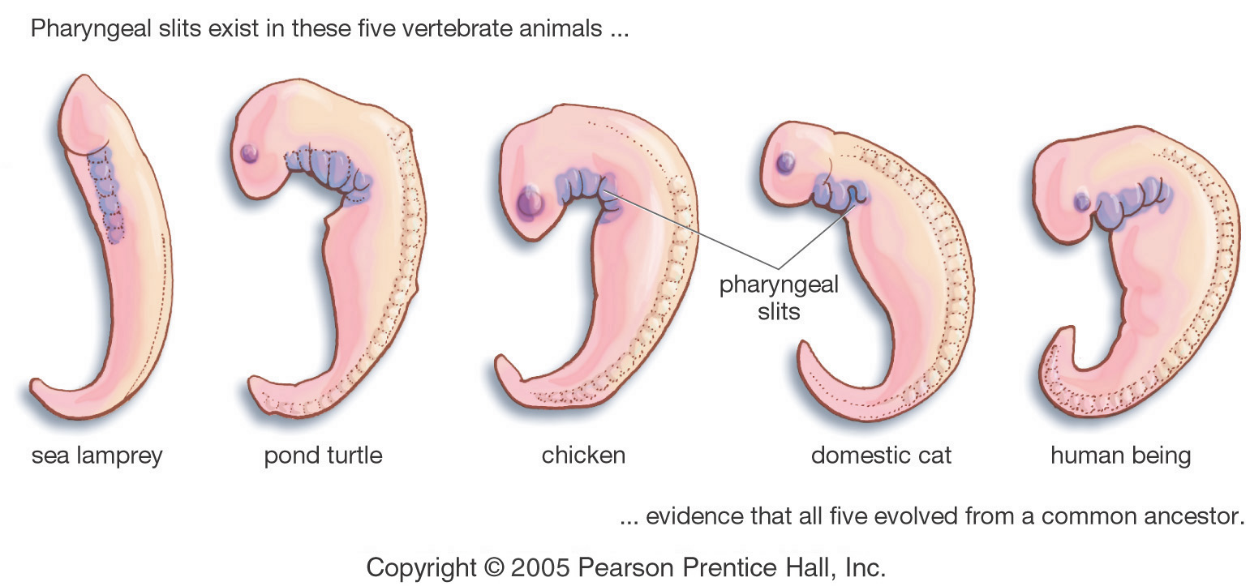

Slide 14
I. Contributors to Darwin
Thomas Malthus (1766-1834) – proposed that there were natural limiting factors, such as food resources, which limited a given population.
populations as a whole tend to grow exponentially, whereas natural resources grow arithmetically if they grow at all.
When a population reaches beyond the amount of resources available to its survival, it has reached its carrying capacity.
When a population reaches its carrying capacity a number of limiting factors, such as disease or famine, can occur to bring the population down to naturally acceptable limits

Slide 15
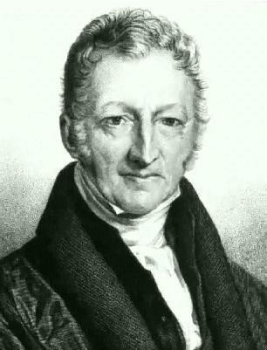
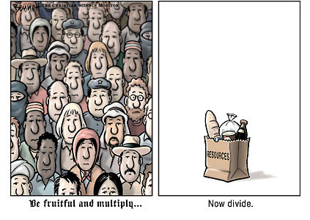
Thomas Malthus

Slide 16
I. Contributors to Darwin
Charles Lyell (1797-1875)
catastrophism theory was wrong. He believed that there primarily have been slower, progressive changes.
Principles of Geology (1830-1833): earth must be very old and that it has been subject to the same sort of natural processes in the past that operate today in shaping the land including erosion, earthquakes, glacial movements, volcanoes, and even the decomposition of plants and animals.
evidence for the theory of uniformitarianism - natural forces now changing the shape of the earth's surface have been operating in the past much the same way. .
helped Darwin understand biological evolution

Slide 17
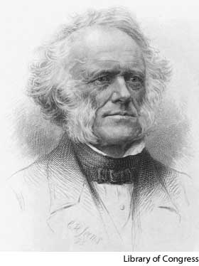
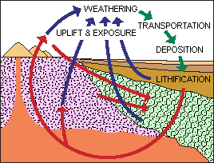
Lyell

Slide 18
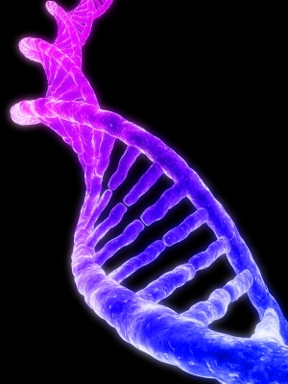
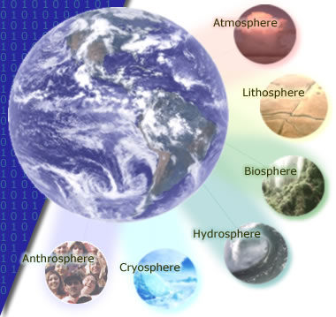
Biogeography - study of the distribution of life forms over geographical areas.
provides evidence for evolution and common descent as well as testable predictions
Molecular Biology: studies macromolecules and the macromolecular mechanisms found in living things, such as the molecular nature of the gene and its mechanisms of gene replication, mutation, & expression.

Slide 19
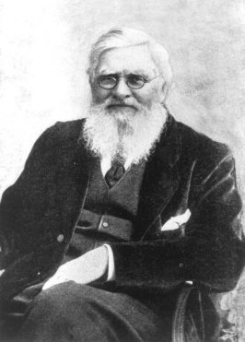
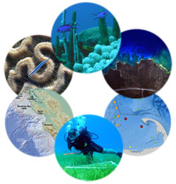
I. Contributors to Darwin
Alfred Russel Wallace (1823–1913) – “father of biogeography”
Independently came to same Conclusion as Darwin that species changed over time because of their struggle for existence
When Darwin read Wallace’s essay, he knew he had to publish his findings

Slide 20
NeoDarwinism: the modification of Darwin’s original theory to include genetics following Mendel’s research
Current Research:
Marc W. Kirschner & John C. Gerhart proposed a new theory of facilitated variation, which seeks to explain how animals generate changes in their physical appearance from genetic changes. They suggest that small changes in core processes have resulted in large scale changes in different organisms.

Slide 21
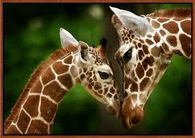
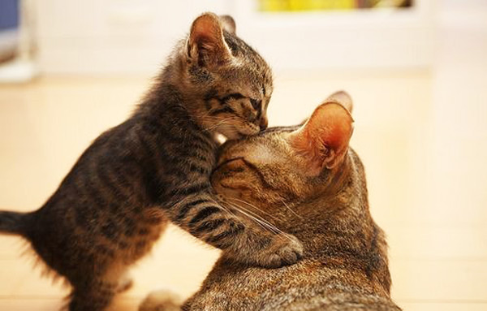
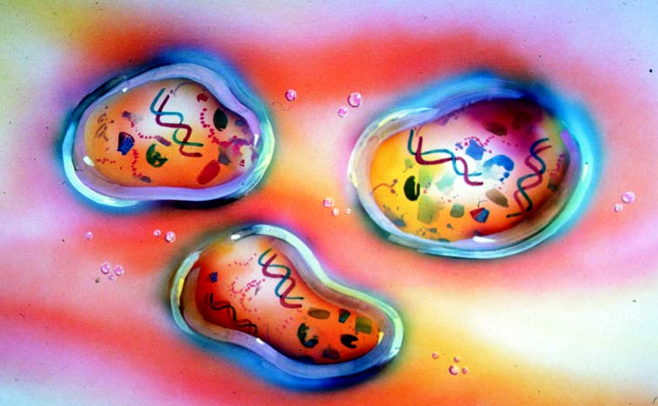
II. Experiments
Spontaneous Generation: principle that states life originates from inanimate matter (abiogenesis)

Slide 22
Aristotle (384-322 B.C.)
One of the earliest known thinkers to believe in spontaneous generation.
Spontaneous generation (abiogenesis): idea that living organisms came from nonliving matter.
Until the late 1800s, many still believed in this idea, which we now know is incorrect based on the Cell Theory.

Slide 23
II. Experiments
1668: Francisco Redi: Italian physician – conducted experiments using dead meat to disprove spontaneous generation
filled 6 jars with decaying meat, 3 were covered, and 3 uncovered
open jars attracted flies, which laid eggs on the meat
supporters of spontaneous generation stated the lack of fresh air- not the flies- prevented the appearance of maggots
Redi conducted a second experiment using nets for coverage, yielding the same results

Slide 24
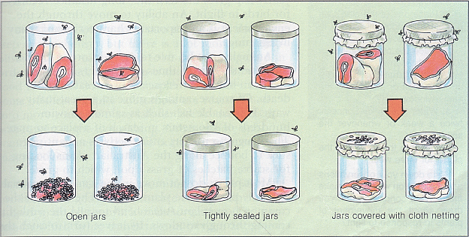

Slide 25
II. Experiments
1745: John Needham: strong advocate of spontaneous generation, and performed an experiment that he felt supported his belief in abiogenesis
heated chicken and corn broths, poured them into covered flasks.
Soon after the broths cooled, they teemed with microorganisms, prompting Needham to claim that the organisms arose through spontaneous generation
Needham's work was contradicted by another investigator, the Italian physiologist Lazzaro Spallanzani.

Slide 26
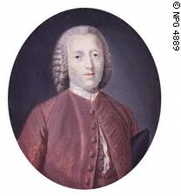

Slide 27
II. Experiments
Lazzaro Spallanzani:
Conducted Needham’s experiment 20 years later, but sealed flasks before heating
Suggested that Needham’s broths were contaminated before being sealed
Needham counterclaimed that heat destroyed the "vital force" (air) needed for spontaneous generation

Slide 28
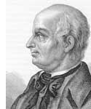
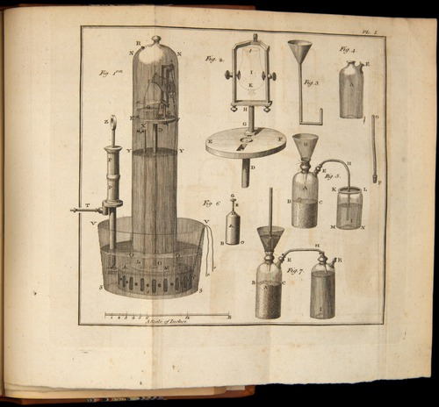

Slide 29
II. Experiments
1860: Louis Pasteur : conducted a series of classic experiments to demonstrate
microorganisms are present in the air and can contaminate solutions and the air itself does not create microbes
- filled short-necked flasks with beef broth and boiled them, leaving some opened to the air to cool and sealing others. While the sealed flasks remained free of microorganisms, the open flasks were contaminated within a few days indicating the air had microorganisms.
- 2nd experiments using S-shaped (swan necked) curve flasks that trapped microorganisms in the neck while still allowing air in, preventing them from reaching the broths
helped develop the germ theory of disease
Father of microbiology & immunology, created first vaccines (rabies, chicken cholera, bacterial anthrax), first to understand yeast fermentation, created pasteurization process, antiseptic technique.
Law of Biogenesis: process of life forms producing other life forms

Slide 30
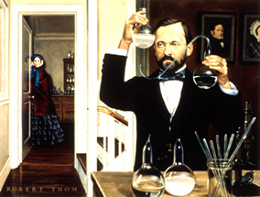
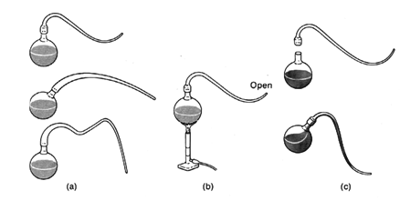

Slide 31
III. Chemical & Organic Evolution
A. Chemical Evolution: a variety of theories that claim life originated through purely chemical transformations of matter
starting from primordial simplicity, such chemical transformations are supposed to have eventually brought about the living cell

Slide 32
III. Chemical & Organic Evolution
B. Organic Evolution: is the modification of living organisms during their descent, generation by generation, from common ancestors.
Organic evolution includes two major processes:
1. anagenesis: the alteration of the genetic properties of a single lineage over time
2. cladogenesis: or branching (a single species splits into two or more distinct species that continue to change)

Slide 33
III. Chemical & Organic Evolution
C. Applications of Chemical & Organic Evolution
1. Scientists have shown that electrical discharges of lightning, radioactivity and UV light have cause the elements in the early atmosphere to form the basic molecules of biochemistry
(ex: nucleotides, simple proteins, & ATP)
2. Over time, these molecules began to collaborate and perform metabolic processes, eventually forming the first cells.
a. these cells were the first anaerobic heterotrophs
b. they fed on the organic material present on the early earth
3. The metabolic processes carried out by these cells release carbon dioxide into the atmosphere

Slide 34
III. Chemical & Organic Evolution
4. The presence of CO2 in the atmosphere led to the evolution of photosynthetic autotrophs
5. Increase oxygen levels in the atmosphere caused the heterotrophic cells to evolve to carry out aerobic respiration
6. These cells eventually became the dominant life forms on Earth.

Slide 35
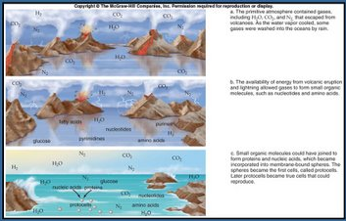
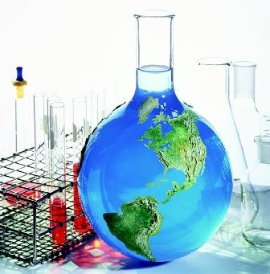

Slide 36
D. Oparin-Haldane Hypothesis
Alexander Oparin suggested that the atmosphere of early earth contained water vapor, ammonia, hydrogen gas, & methane, but no free oxygen (O₂).
Because free oxygen is so reactive, it would destroy organic molecules as fast as they could be formed. He believed that with the energy from lightning & heat from volcanoes, simple chemicals would combine to form increasingly more complex organic compounds.
JBS Haldane also came up with a similar hypothesis. Haldane believed that energy from the sun could cause the same atmospheric gases to react & form organic compounds. As the earth cooled, the early oceans would have been filled with these organic compounds. Furthermore, Haldane concluded that the organic compounds combined over time (maybe millions of years) into virus-like organisms, which then evolved into the first living cells.
Oparin & Haldane both had detailed ideas about life evolving from chemicals; however, neither scientist performed experiments to test these ideas.

Slide 37
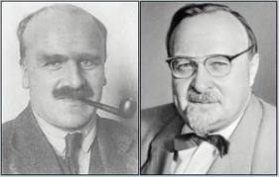
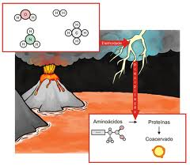

Slide 38
E. Miller-Urey Experiment
Stanley Miller & Harold Urey tested part of the Oparin-Haldane hypothesis in 1953.
They created a set-up in which no oxygen was present. They then boiled water to form water vapor & introduced ammonia, methane, & hydrogen gases. Following this, electric sparks were used to simulate lightning. The resulting chemicals cooled. Miller & Urey found organic compounds in the mixture, including several amino acids that are found in proteins.
Other scientists have since repeated their experiment and have gotten the same results. However, they argue that their experiment used a large amount of heat and electrical energy (lightning), which would require constant storms to produce.

Slide 39
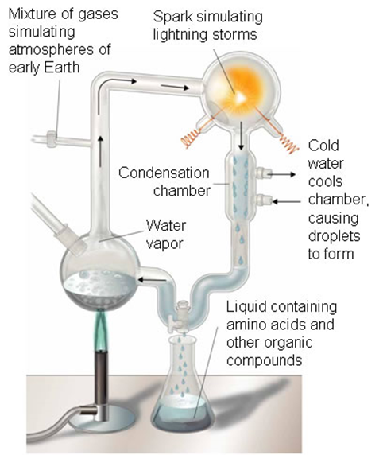

Slide 40
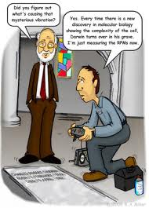
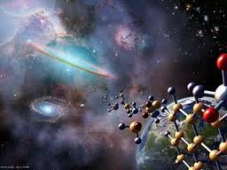

Slide 41
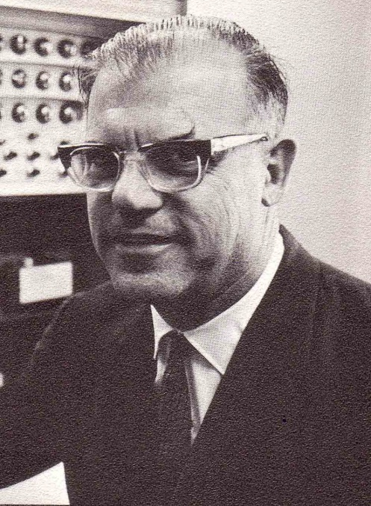
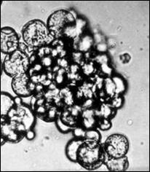
F. Sidney Fox
In the 1950s & 1960s, Sidney Fox believed that if amino acids were present in early earth, then they would react together in just the right way to form proteins. He performed experiments to see if proteins could be formed. When his experiments were completed, he created what we call proteinoid microspheres or protocells. These were believed to be the beginnings of forming a living cell. Inevitably, this lead to the Endosymbiotic Theory.

Slide 42
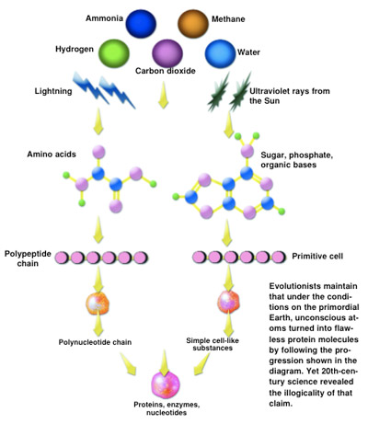

Slide 43
Terminology review:
Aerobic: existing with oxygen
Anaerobic: existing without oxygen
Autotroph: makes its own food from the sun’s energy or chemicals
Heterotroph: cannot make its own food, requires food from outside source
Prokaryotic: no nucleus
Eukaryotic: has nucleus and membrane-bound organelles

Slide 44
Endosymbiotic Theory:
Scientists cannot decide when or how the first cells evolved
Since early Earth contained little or no oxygen in the atmosphere they believe the first cells were anaerobic prokaryotes, since they are simpler without a nucleus or organelles
Then, it is believed these prokaryotes evolved to create their own food (photosynthetic or chemosynthetic autotrophs)
Cyanobacteria were then believed to have evolved to carry out true photosynthesis and produce oxygen then use this oxygen to create their own energy (autotrophic, aerobic)
Anaerobic, heterotrophic bacteria, aerobic bacteria, photosynthetic bacteria

Slide 45
Lynn Margulis (late 1960s) found that mitochondria and chloroplasts have their own DNA leading her to believe they were of symbiotic origin.
Symbiotic relationships occur when two separate organisms have a close relationship and benefits at least one organism.
This led to the endosymbiotic theory development because scientists realized mitochondria are similar in size and structure to bacteria (no organelles, outer membrane, DNA, ribosomes, divide by binary fission)

Slide 46
Margulis proposed that a large, primitive anaerobic cell could have engulfed (ate) an aerobic prokaryote (bacteria) to form a symbiotic relationship.
Over time the aerobic prokaryote could have become a mitochondria
Eventually evolving into eukaryotic cells (animal, plant, fungi, protists)
If an aerobic eukaryote engulfed a photosynthetic bacteria, the bacteria could become a chloroplast in the same way becoming an ancestor for plants

Slide 47
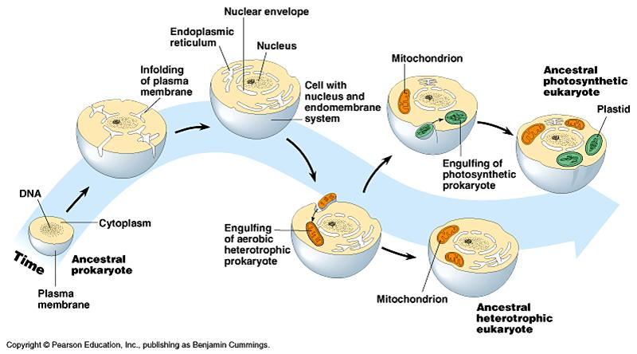
This is known as the ENDOSYMBIOTIC THEORY (Endosymbiosis)

Slide 48
Alternate Ideas:
Some scientists believe life came from deep sea vents
Panspermia: life (primitive organic compounds) came from outer space (meteorite)
RNA World Hypothesis: in 1967, Carl Woese proposed RNA was the first organic compound

